Slide 1

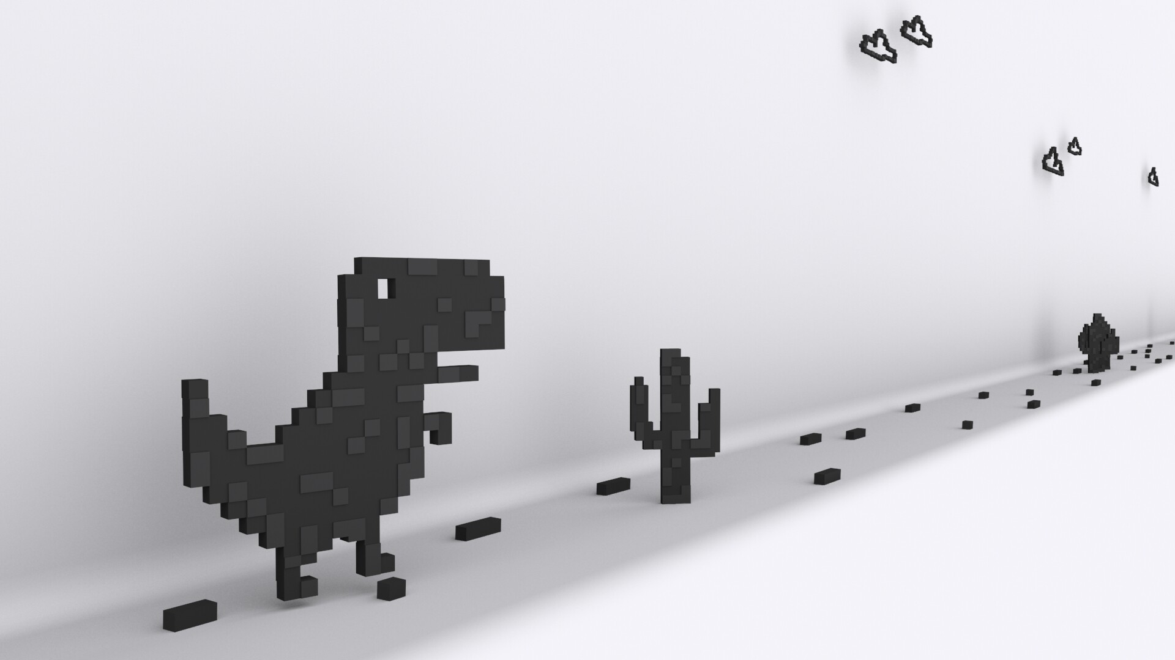
Capstone Project Project Topic: Trex Dino Bot Team Name: Dino GG
Implemented by -
Suresh
Himanshu Sinha
Dennis Issac
Ravina Jivnani
Guided by – Marcos Bittencourt

Slide 2
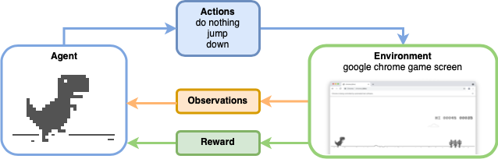
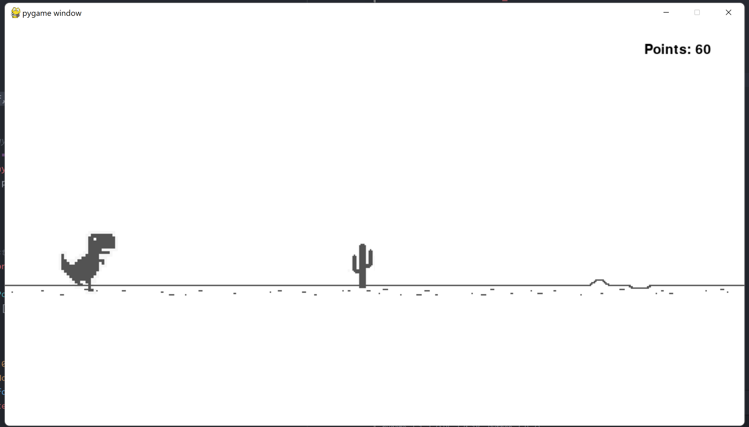
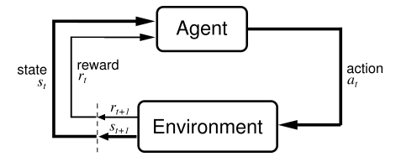
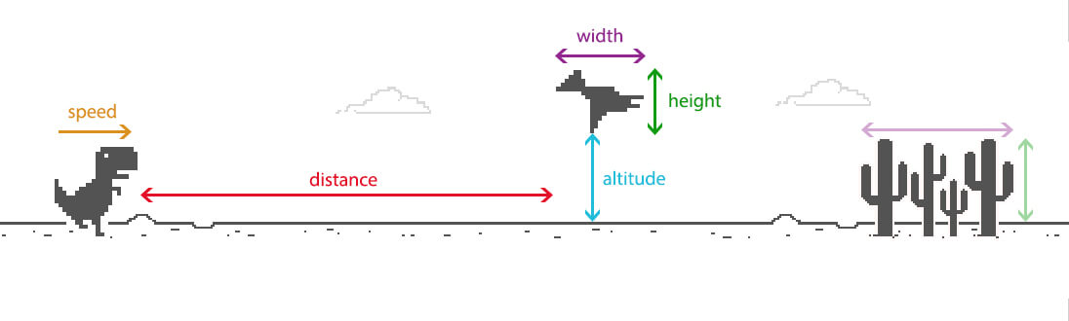
Product

Slide 3
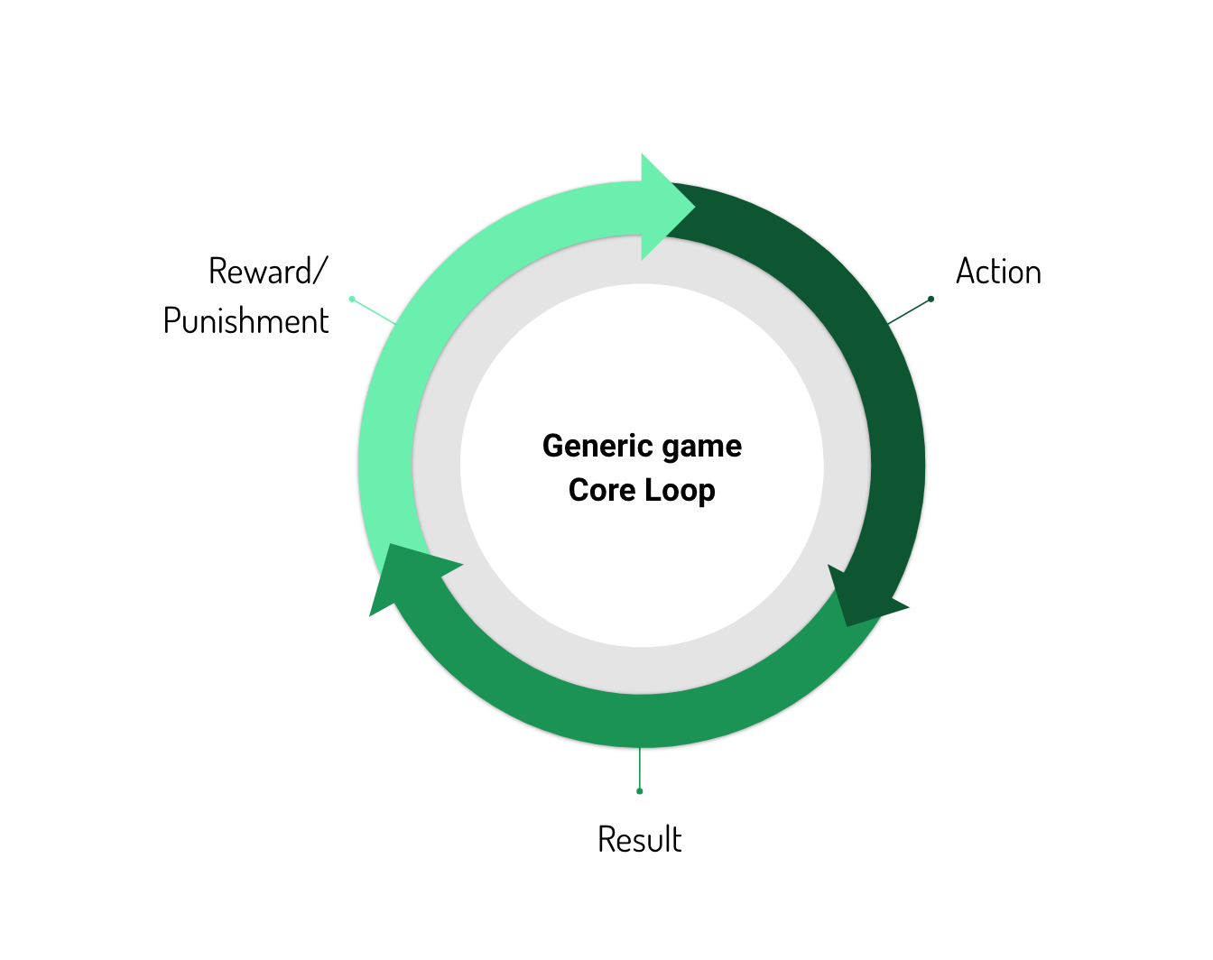
Features
User will be able to play our Dino game without interruptions or difficulties.
Teach the bot to play the Dino game using reinforcement learning.
The bot should be able to play the game without human assistance.
As the gamer progresses through the game, the difficulty level rises with increasing number of obstacles.

Slide 4
THANK YOU!

